Slide 1



Primitive Data Types and Variables
Integer, Floating-Point, Text Data, Variables, Literals
Svetlin Nakov
Technical Trainer
www.nakov.com
Software University
http://softuni.bg

Slide 2
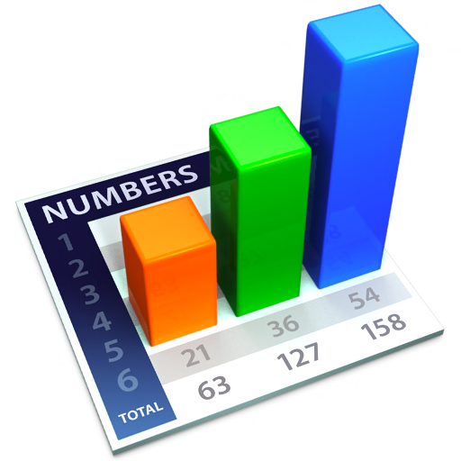



Table of Contents
Primitive Data Types
Integer
Floating-Point / Decimal Floating-Point
Boolean
Character
String
Object
Declaring and Using Variables
Identifiers, Variables, Literals
Nullable Types

Slide 3


Primitive Data Types

Slide 4
How Computing Works?
Computers are machines that process data
Data is stored in the computer memory in variables
Variables have name, data type and value
Example of variable definition and assignment in C#
When processed, data is stored back into variables
Variable name
Data type
int count = 5;
Variable value

Slide 5

What Is a Data Type?
A data type:
Is a domain of values of similar characteristics
Defines the type of information stored in the computer memory (in a variable)
Examples:
Positive integers: 1, 2, 3, …
Alphabetical characters: a, b, c, …
Days of week: Monday, Tuesday, …

Slide 6
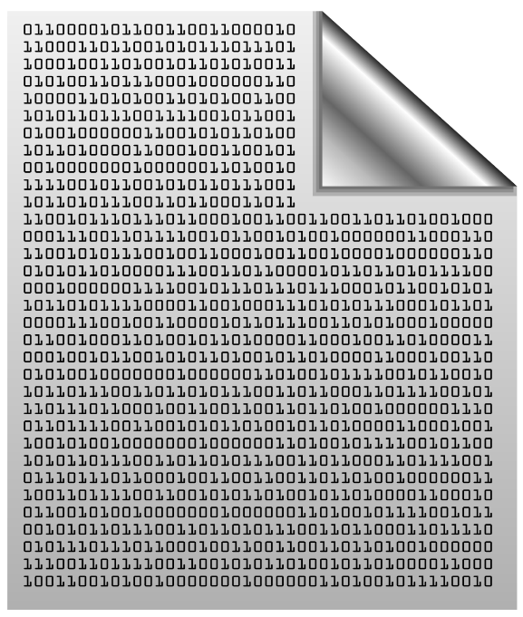

Data Type Characteristics
A data type has:
Name (C# keyword or .NET type)
Size (how much memory is used)
Default value
Example:
Integer numbers in C#
Name: int
Size: 32 bits (4 bytes)
Default value: 0
int: sequence of 32 bits in the memory
int: 4 sequential bytes in the memory

Slide 7

Integer Types
sbyte
int
byte
uint
short
long
ushort
ulong

Slide 8
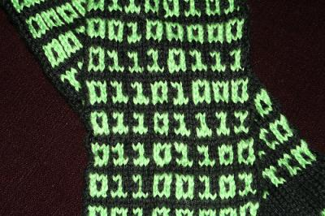
What are Integer Types?
int
Integer types:
Represent whole numbers
May be signed or unsigned
Have range of values, depending on the size of memory used
The default value of integer types is:
0 – for integer types, except
0L – for the long type
short
long

Slide 9
Integer Types
int
sbyte
sbyte (-128 to 127): signed 8-bit
byte (0 to 255): unsigned 8-bit
short (-32,768 to 32,767): signed 16-bit
ushort (0 to 65,535): unsigned 16-bit
int (-2,147,483,648 to 2,147,483,647): signed 32-bit
uint (0 to 4,294,967,295): unsigned 32-bit
long (-9,223,372,036,854,775,808 to 9,223,372,036,854,775,807): signed 64-bit
ulong (0 to 18,446,744,073,709,551,615): unsigned 64-bit
uint
byte
long
short
ulong
ushort

Slide 10
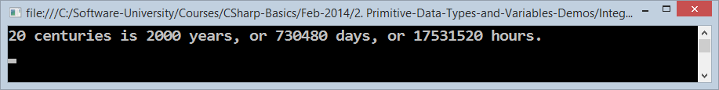
Measuring Time – Example
Depending on the unit of measure we may use different data types:
byte centuries = 20; // A small number (up to 255)
ushort years = 2000; // A small number (up to 32767)
uint days = 730480; // A large number (up to 4.3 billions)
ulong hours = 17531520; // A very big number (up to 18.4*10^18)
Console.WriteLine( "{0} centuries is {1} years, or {2} days, or {3} hours.", centuries, years, days, hours);

Slide 11

Integer Types
Live Demo
int
sbyte
uint
byte
long
short
ulong
ushort

Slide 12

Floating-Point and Decimal Floating-Point Types
double
decimal
float

Slide 13
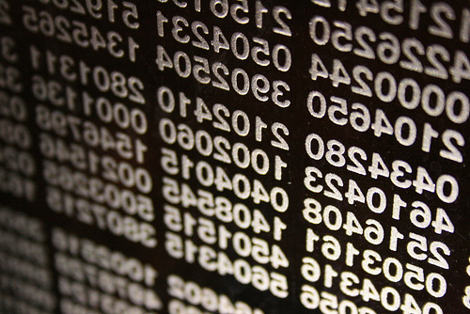
What are Floating-Point Types?
double
Floating-point types:
Represent real numbers
May be signed or unsigned
Have range of values and different precision depending on the used memory
Can behave abnormally in the calculations
float

Slide 14

Floating-Point Types
Floating-point types are:
float (±1.5 × 10⁻⁴⁵ to ±3.4 × 10³⁸)
32-bits, precision of 7 digits
double (±5.0 × 10⁻³²⁴ to ±1.7 × 10³⁰⁸)
64-bits, precision of 15-16 digits
The default value of floating-point types:
Is 0.0F for the float type
Is 0.0D for the double type
double
float

Slide 15
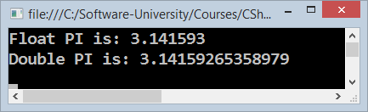
PI Precision – Example
Difference in precision when using float and double:
NOTE: The “f” suffix in the first statement!
Real numbers are by default interpreted as double!
One should explicitly convert them to float
float floatPI = 3.141592653589793238f;
double doublePI = 3.141592653589793238;
Console.WriteLine("Float PI is: {0}", floatPI);
Console.WriteLine("Double PI is: {0}", doublePI);

Slide 16

Abnormalities in the Floating-Point Calculations
Sometimes abnormalities can be observed when using floating-point numbers
Comparing floating-point numbers can not be performed directly with the == operator
double a = 1.0f;
double b = 0.33f;
double sum = 1.33f;
bool equal = (a+b == sum); // False!!!
Console.WriteLine("a+b={0} sum={1} equal={2}", a+b, sum, equal);

Slide 17

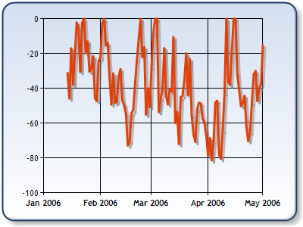
Decimal Floating-Point Types
There is a special decimal floating-point real number type in C#:
decimal (±1,0 × 10⁻²⁸ to ±7,9 × 10²⁸)
128-bits, precision of 28-29 digits
Used for financial calculations
No round-off errors
Almost no loss of precision
The default value of decimal type is:
0.0M (M is the suffix for decimal numbers)
decimal

Slide 18

Floating-Point and Decimal Floating-Point Types
Live Demo

Slide 19


Boolean Type
true
false

Slide 20

The Boolean Data Type
The Boolean data type:
Is declared by the bool keyword
Has two possible values: true and false
Is useful in logical expressions
The default value is false

Slide 21
Boolean Values – Example
Example of boolean variables taking values of true or false:
int a = 1;
int b = 2;
bool greaterAB = (a > b);
Console.WriteLine(greaterAB); // False
bool equalA1 = (a == 1);
Console.WriteLine(equalA1); // True

Slide 22

Boolean Type
true
false
Live Demo

Slide 23
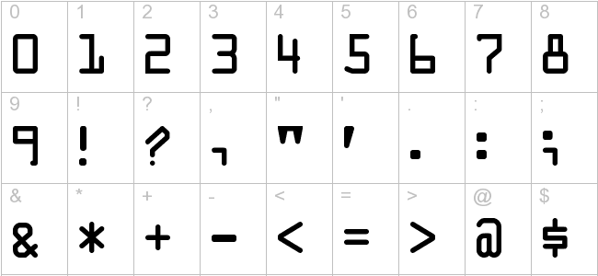
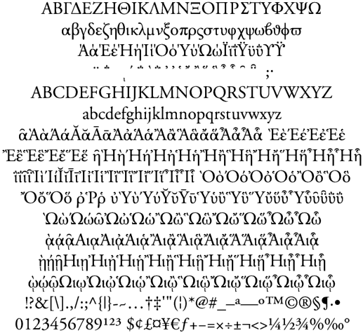

Character Type
char

Slide 24
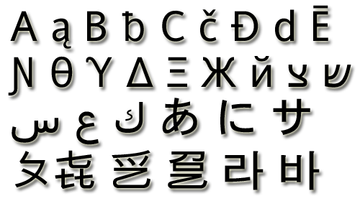
The Character Data Type
The character data type:
Represents symbolic information
Is declared by the char keyword
Gives each symbol a corresponding integer code
Has a '\0' default value
Takes 16 bits of memory (from U+0000 to U+FFFF)
Holds a single Unicode character (or part of character)

Slide 25
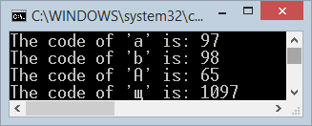
Characters and Codes
The example below shows that every character has an unique Unicode code:
char symbol = 'a';
Console.WriteLine("The code of '{0}' is: {1}", symbol, (int) symbol);
symbol = 'b';
Console.WriteLine("The code of '{0}' is: {1}", symbol, (int) symbol);
symbol = 'A';
Console.WriteLine("The code of '{0}' is: {1}", symbol, (int) symbol);
symbol = 'щ'; // Cyrillic letter 'sht'
Console.WriteLine("The code of '{0}' is: {1}", symbol, (int)symbol);

Slide 26

Character Type
char
Live Demo

Slide 27
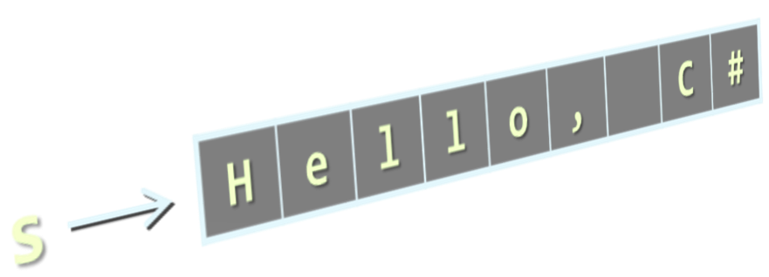
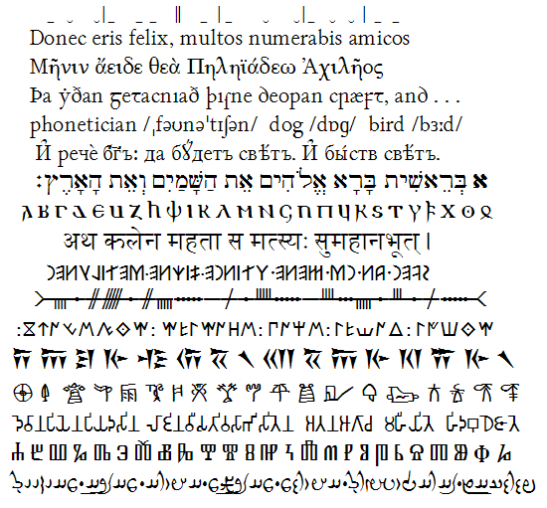
String Type
string

Slide 28

The String Data Type
The string data type:
Represents a sequence of characters
Is declared by the string keyword
Has a default value null (no value)
Strings are enclosed in quotes:
Strings can be concatenated
Using the + operator
string
string s = "Hello, C#";

Slide 29
Saying Hello – Example
Concatenating the names of a person to obtain the full name:
We can concatenate strings and numbers as well:
string firstName = "Ivan";
string lastName = "Ivanov";
Console.WriteLine("Hello, {0}!", firstName);
string fullName = firstName + " " + lastName;
Console.WriteLine("Your full name is {0}.", fullName);
int age = 21;
Console.WriteLine("Hello, I am " + age + " years old");

Slide 30

String Type
Live Demo
string

Slide 31

Object Type
object

Slide 32
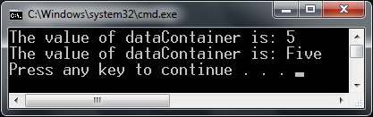

The Object Type
The object type:
Is declared by the object keyword
Is the base type of all other types
Can hold values of any type
object
object dataContainer = 5;
Console.Write("The value of dataContainer is: ");
Console.WriteLine(dataContainer);
dataContainer = "Five";
Console.Write("The value of dataContainer is: ");
Console.WriteLine(dataContainer);

Slide 33

Objects
Live Demo
object

Slide 34






Introducing Variables
length
p
q
name
value
i
str
radius
size

Slide 35
What Is a Variable?
Variables keep data in the computer memory
A variable is a:
Placeholder of information that can be changed at run-time
Variables allow you to:
Store information
Retrieve the stored information
Change the stored information
lastName

Slide 36
Variable Characteristics
A variable has:
Name
Type (of stored data)
Value
Example:
Name: counter
Type: int
Value: 5
counter
5
int counter = 5;
int

Slide 37
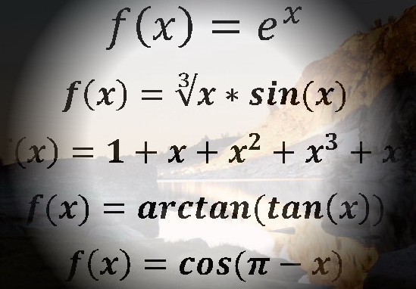
Declaring and Using Variables
counter
5
int

Slide 38
Declaring Variables
When declaring a variable we:
Specify its type
Specify its name (called identifier)
May give it an initial value
The syntax is the following:
Example:
height
200
int
<data_type> <identifier> [= <initialization>];
int height = 200;

Slide 39
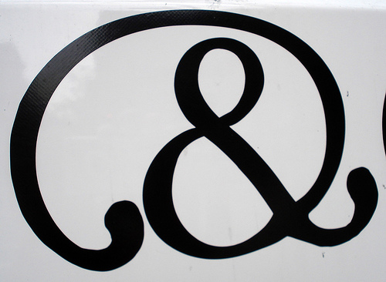
Identifiers
Identifiers may consist of:
Letters (Unicode)
Digits [0-9]
Underscore "_"
Examples: count, firstName, Page
Identifiers
Can begin only with a letter or an underscore
Cannot be a C# keyword (like int and class)

Slide 40

Identifiers (2)
Identifiers
Should have a descriptive name
E.g. firstName, not dasfas or p17
It is recommended to use only Latin letters
Should be neither too long nor too short
Note:
In C# small letters are considered different than the capital letters (case sensitivity)

Slide 41
Identifiers – Examples
Examples of syntactically correct identifiers:
Examples of syntactically incorrect identifiers:
int New = 2; // here N is capital
int _2Pac; // this identifiers begins with underscore _
string поздрав = "Hello"; // Unicode symbols are acceptable
string greeting = "Hello"; // more appropriate name
int n = 100; // undescriptive
int numberOfClients = 100; // good, descriptive name
int numberOfPrivateClientOfTheFirm = 100; // overdescriptive
int new; // new is a keyword
int 2Pac; // cannot begin with a digit

Slide 42

Assigning Values To Variables
height
200
int

Slide 43

Assigning Values
=
Assigning values to variables
Use the = operator
The = operator
Holds a variable identifier on the left
Value of the corresponding data type on the right
Or expression of compatible type
Could be used in a cascade calling
Where assigning is done from right to left
height
200
int

Slide 44

Assigning Values – Examples
int firstValue = 5;
int secondValue;
int thirdValue;
// Using an already declared variable:
secondValue = firstValue;
// The following cascade calling assigns
// 3 to firstValue and then firstValue
// to thirdValue, so both variables have
// the value 3 as a result:
thirdValue = firstValue = 3; // Avoid cascading assignments!

Slide 45
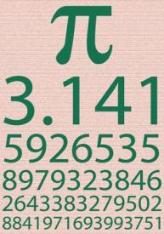
Initializing Variables
Initializing
Means "to assign an initial value"
Must be done before the variable is used!
Several ways of initializing:
By using the new keyword
By using a literal expression
By referring to an already initialized variable
height
200
int

Slide 46
Initialization – Examples
Example of variable initializations:
// The following would assign the default
// value of the int type to num:
int num = new int(); // num = 0
// This is how we use a literal expression:
float heightInMeters = 1.74f;
// Here we use an already initialized variable:
string greeting = "Hello World!";
string message = greeting;

Slide 47
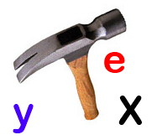

Assigning and Initializing Variables
Live Demo
height
200
int

Slide 48

Literals
true
12.76m
null
0xFE
-0.307f
6.02e+23
@"Hi\r\n"
"\uE52B"
2034567324L
3.14159206
"\t\r\n\r\n\r\n"

Slide 49

What are Literals?
Literals are:
Representations of values in the source code
There are several types of literals
Boolean
Integer
Real
Character
String
The null literal

Slide 50
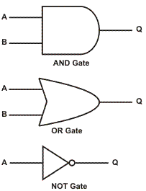
Boolean and Integer Literals
The boolean literals are:
true
false
The integer literals:
Are used for variables of type int, uint, long, and ulong
Consist of digits
May have a sign (+,-)
May be in a hexadecimal format

Slide 51
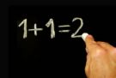
Integer Literals
int
sbyte
uint
long
byte
short
ulong
Examples of integer literals:
The '0x' and '0X' prefixes mean a hexadecimal value
E.g. 0xFE, 0xA8F1, 0xFFFFFFFF
The 'u' and 'U' suffixes mean a ulong or uint type
E.g. 12345678U, 0U
The 'l' and 'L' suffixes mean a long or ulong
E.g. 9876543L, 0L
ushort

Slide 52
Integer Literals – Examples
Note: the letter ‘l’ is easily confused with the digit ‘1’
So it’s better to use ‘L’
// The following variables are initialized with the same value:
int numberInHex = -0x10;
int numberInDec = -16;
// The following causes an error, because 234u is of type uint
int unsignedInt = 234u;
// The following causes an error, because 234L is of type long
int longInt = 234L;

Slide 53

Real Literals
The real literals:
Are used for values of type float, double and decimal
May consist of digits, a sign and “.”
May be in exponential notation: 6.02e+23
The “f” and “F” suffixes mean float
The “d” and “D” suffixes mean double
The “m” and “M” suffixes mean decimal
The default interpretation is double

Slide 54
Real Literals – Example
Example of incorrect float literal:
A correct way to assign a floating-point value
Exponential format for assigning float values:
// The following causes an error because 12.5 is double by default
float realNumber = 12.5;
// The following is the correct way of assigning the value:
float realNumber = 12.5f;
// This is the same value in exponential format:
float realNumber = 6.02e+23;
float realNumber = 1.25e-7f;

Slide 55


Character Literals
The character literals:
Are used for values of the char type
Consist of two single quotes surrounding the character value:
The value may be:
Symbol
The code of the symbol
Escaping sequence
'<value>'

Slide 56
Escaping Sequences
Escaping sequences are:
Means of presenting a symbol that is usually interpreted otherwise (like ')
Means of presenting system symbols (like the new line symbol)
Common escaping sequences are:
\' for single quote \" for double quote
\\ for backslash \n for new line
\uXXXX for denoting any other Unicode symbol

Slide 57
Character Literals – Example
Examples of different character literals:
char symbol = 'a'; // An ordinary symbol
symbol = '\u006F'; // Unicode symbol code in a
// hexadecimal format (letter 'o')
symbol = '\u8449'; // 葉 (Leaf in Traditional Chinese)
symbol = '\''; // Assigning the single quote symbol
symbol = '\\'; // Assigning the backslash symbol
symbol = '\n'; // Assigning new line symbol
symbol = '\t'; // Assigning TAB symbol
symbol = "a"; // Incorrect: use single quotes

Slide 58
String Literals
String literals:
Are used for values of the string type
Consist of two double quotes surrounding the value: "<value>"
The value is a sequence of character literals
May have a @ prefix which ignores the used escaping sequences: @"<value>"
string s = "I am a sting literal";
string s = @"C:\WINDOWS\System32\drivers\beep.sys";

Slide 59
String Literals – Examples
Benefits of quoted strings (with the @ prefix):
In quoted strings "" is used instead of \"!
// Here is a string literal using escape sequences
string quotation = "\"Hello, Jude\", he said.";
string path = "C:\\Windows\\notepad.exe";
// Here is an example of the usage of @
quotation = @"""Hello, Jimmy!"", she answered.";
path = @"C:\Windows\notepad.exe";
string str = @"some
text";

Slide 60
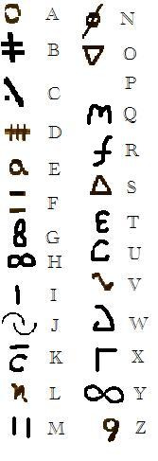
String Literals
Live Demo

Slide 61


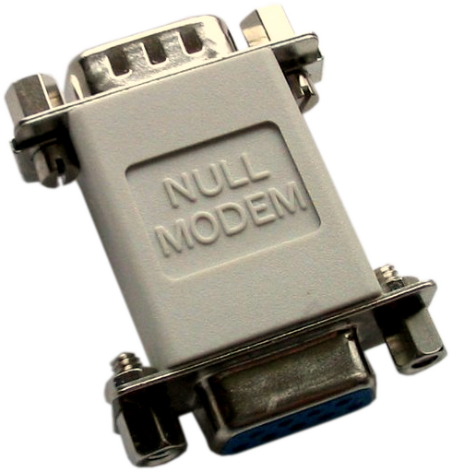
Nullable Types

Slide 62
Nullable Types
Nullable types are instances of the System.Nullable structure
Wrapper around the primitive types
E.g. int?, double?, etc.
Nullabe type can represent the normal range of values for its underlying value type, plus an additional null value
Useful when dealing with databases or other structures that have default value null

Slide 63
Nullable Types – Example
Example with int:
Example with double:
int? someInteger = null;
Console.WriteLine("This is the integer with Null value -> " + someInteger);
someInteger = 5;
Console.WriteLine("This is the integer with value 5 -> " + someInteger);
double? someDouble = null;
Console.WriteLine(
"This is the real number with Null value -> " + someDouble);
someDouble = 2.5;
Console.WriteLine("This is the real number with value 5 -> " + someDouble);

Slide 64


Nullable Types
Live Demo

Slide 65

Summary
Data types are domains of possible values
E.g. number, character, date, string
Integer types hold whole numbers
E.g. 5, -2, 32768
Float and double hold floating-point numbers
E.g. 3.14159206, 6.02e+23
Decimal type holds money and financial information, e.g. 12.80
Boolean type holds true or false

Slide 66
Summary (2)
Character type holds a single Unicode character
E.g. 'A', '\n', '0', '€', '\u0AF4'
String type hold a text, e.g. "Hello C#"
Object type hold any value
E.g. string, number, character, date, …
Variables are named pieces of memory that hold a value
Identifiers are the names of variables, classes, methods, etc.
Literals are the values of the primitive types, e.g. 0xFE, '\uF7B3'
Nullable types can hold a value or null (absence of value)

Slide 67

Primitive Data Types and Variables
http://softuni.bg/courses/csharp-basics/

Slide 68
License
This course (slides, examples, demos, videos, homework, etc.) is licensed under the "Creative Commons Attribution-NonCommercial-ShareAlike 4.0 International" license
Attribution: this work may contain portions from
"Fundamentals of Computer Programming with C#" book by Svetlin Nakov & Co. under CC-BY-SA license
"C# Part I" course by Telerik Academy under CC-BY-NC-SA license

Slide 69







SoftUni Diamond Partners

Slide 70





Free Trainings @ Software University
Software University Foundation – softuni.org
Software University – High-Quality Education, Profession and Job for Software Developers
softuni.bg
Software University @ Facebook
facebook.com/SoftwareUniversity
Software University @ YouTube
youtube.com/SoftwareUniversity
Software University Forums – forum.softuni.bg

